Slide 1



Speech and Elections: Navigating Innovation, AI, Law, and Trust
Dr. Fernanda Buril
Deputy Director
Center for Applied Research and Learning
Nicole Leaver
Digital Democracy Specialist
Center for Applied Research and Learning
Tamar Zhvania
IFES Country Director, Moldova

Slide 2
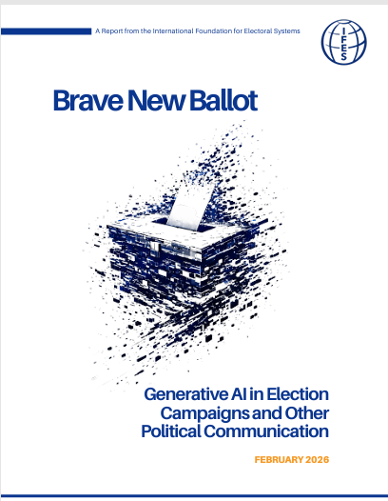


IFES New Reports

Slide 3
GenAI in Election Campaigns
An Overview

Slide 4
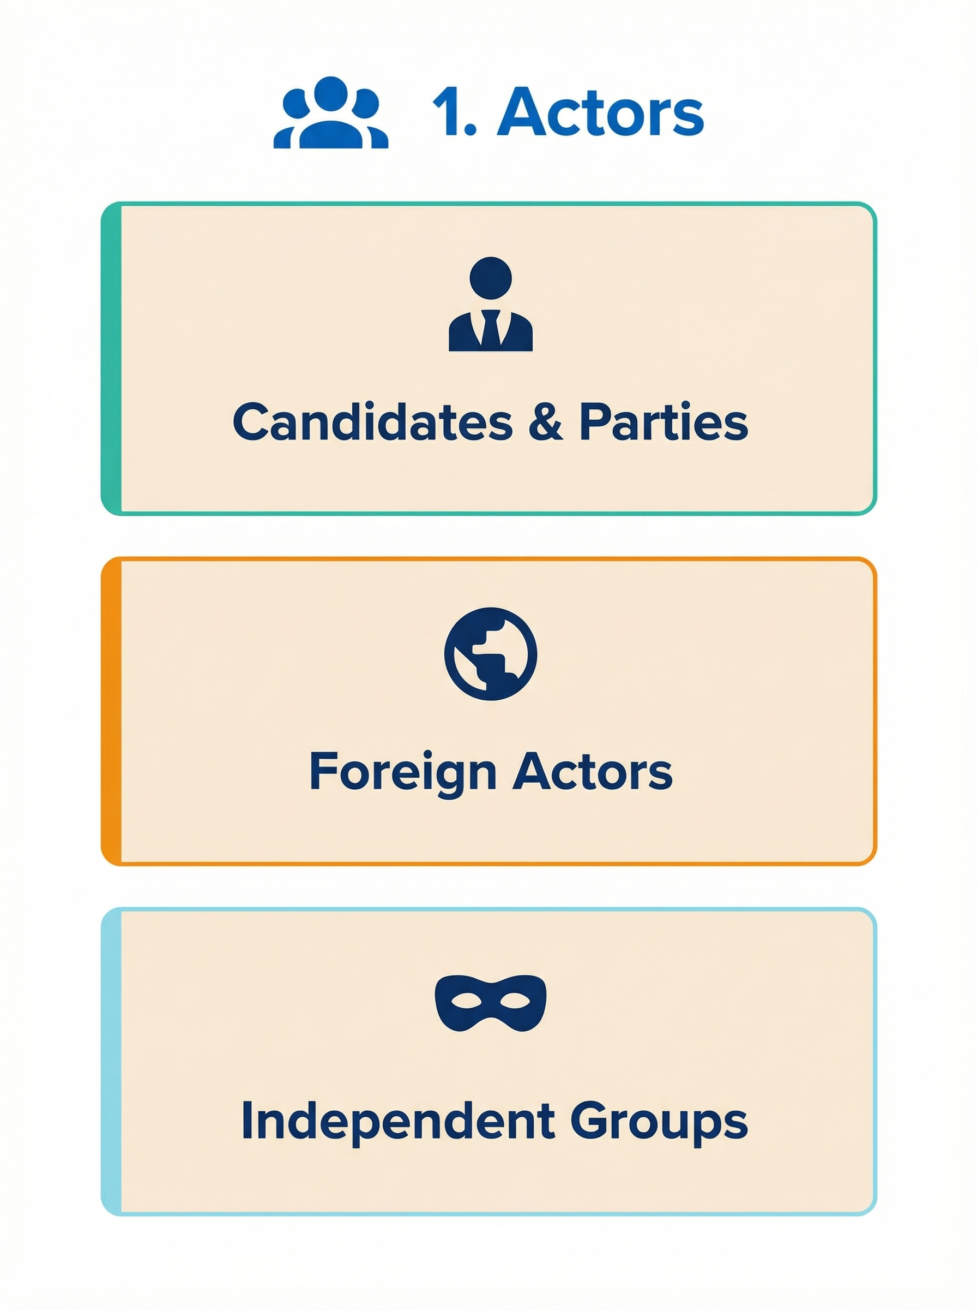
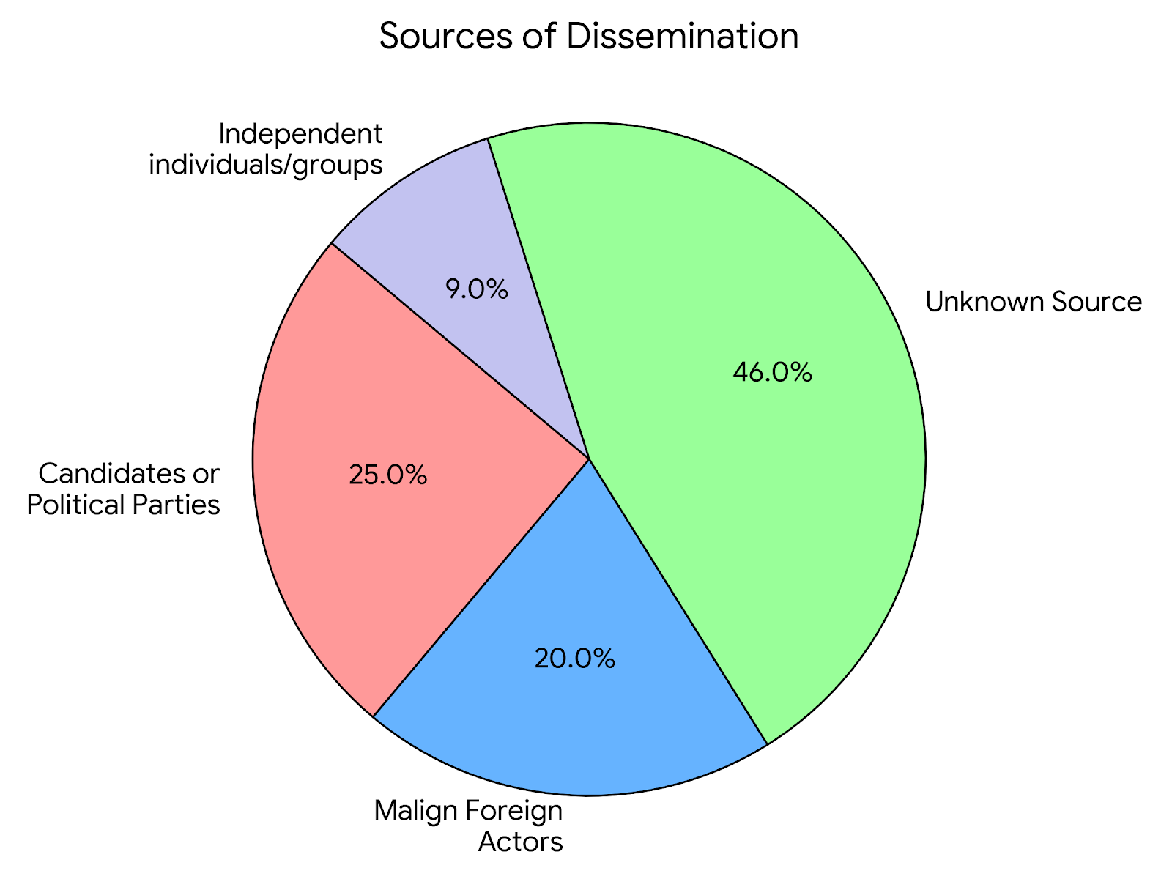
GenAI Use Overview: Actors
In 2024, globally (Source: International Panel on the Information Environment)

Slide 5
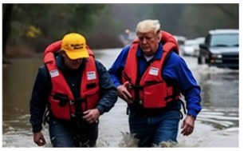
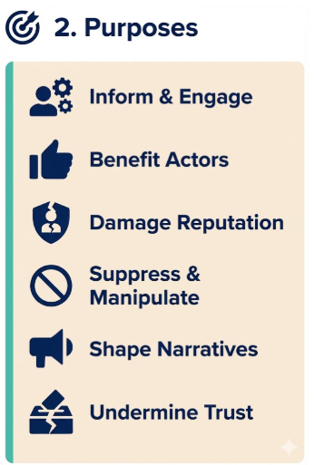

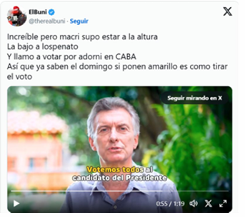

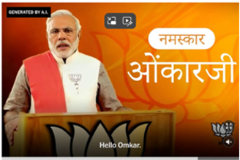
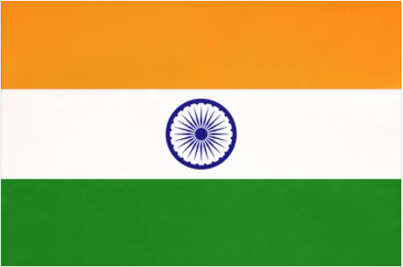
GenAI Use Overview: Purposes

Slide 6
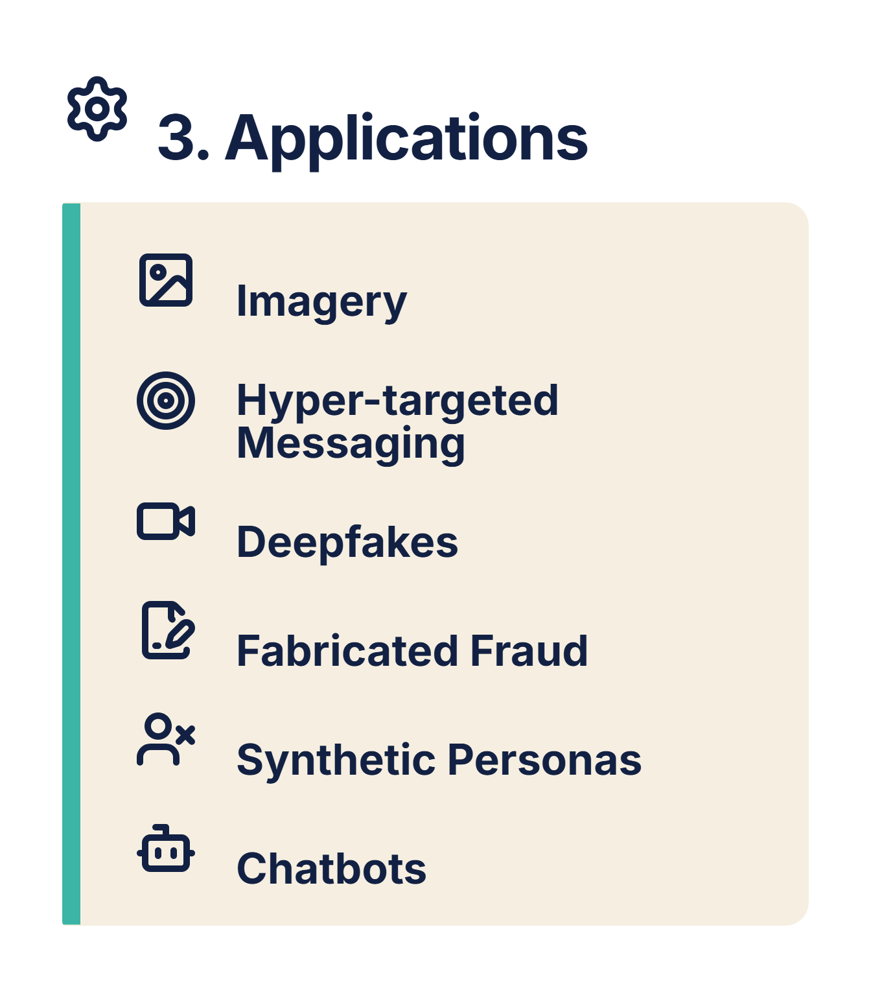
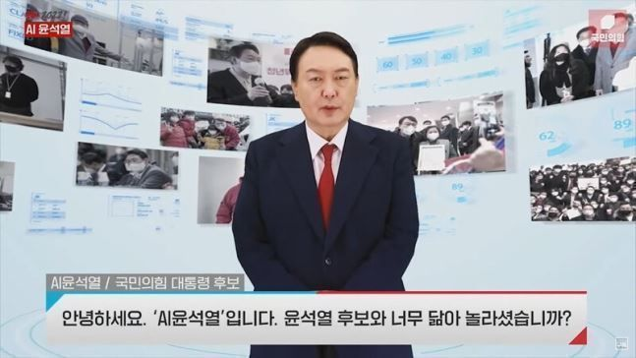
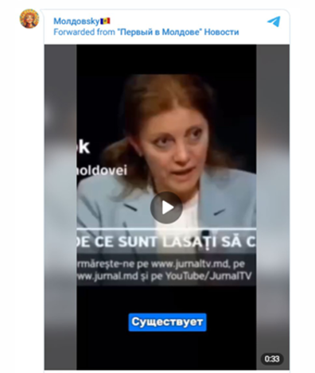




GenAI Use Overview: Applications

Slide 7
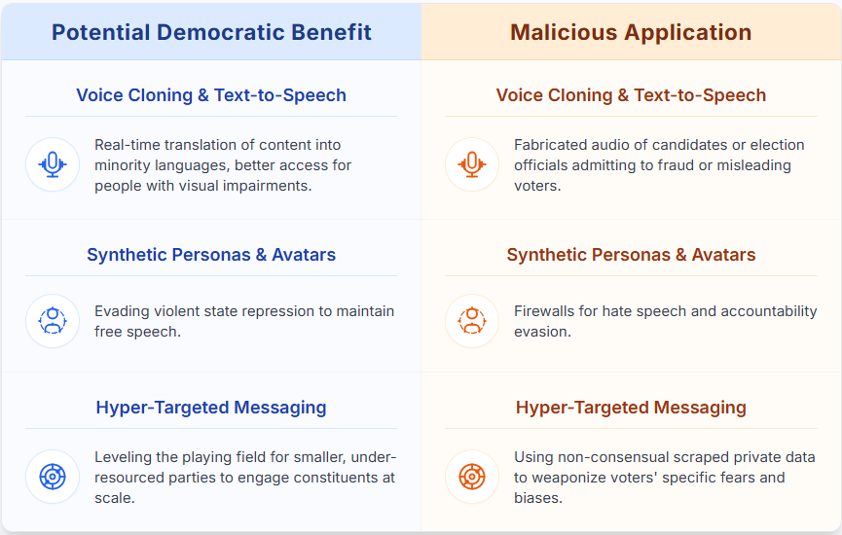
Double-Edged Swords

Slide 8
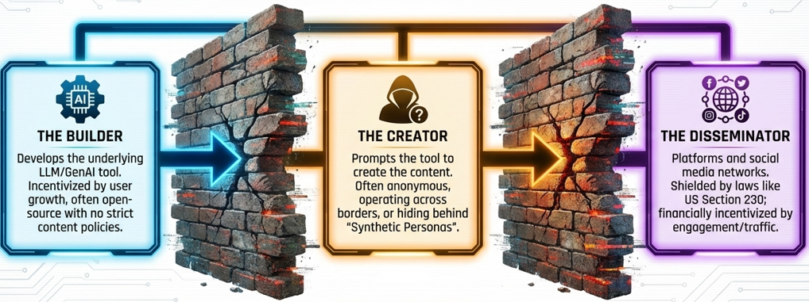
Accountability Challenges
  Establishing the responsibility burden
  Determining consent
  Establishing deception intent
  Preventing accountability evasion through AI personas

Slide 9
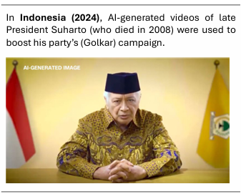
Ethical Challenges
  Unfairness of misrepresentation (negative or positive) of political actors’ characters and attributes
  Misappropriations and limits of consent in the use of a person’s image or likeness

Slide 10
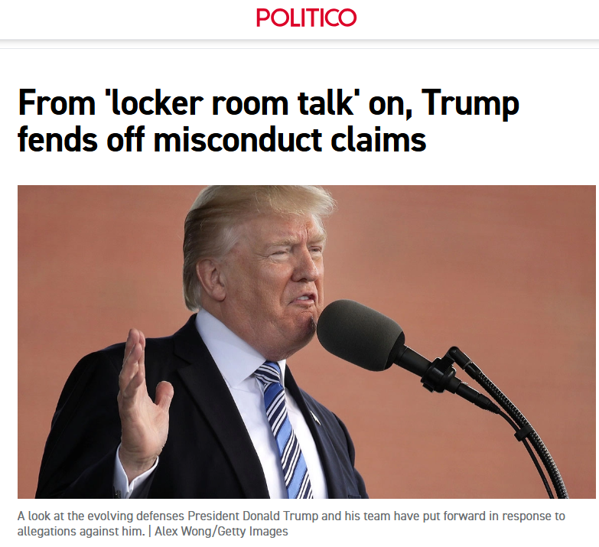
Trust Challenges
  Liar’s Dividend (Chesney & Citron, 2018)
  General distrust in media

Slide 11

Remedies - Direct Disclosure
  Recent research suggest:
  Confusion over “created by AI,” “not created by AI,” “edited with AI,” and “altered or synthetic content”
  Many do not believe or choose to disregard warnings about inauthentic content
  Warnings about inauthenticity do not stop people from sharing content
  Potential for “implied authenticity effect”
  Potential for aversion to synthetic content that is not harmful

Slide 12
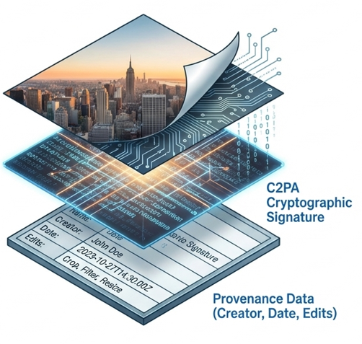
Remedies - Technical Remedies & Challenges: Indirect Disclosure
  Cryptographic signatures and content metadata
    Interoperability
    Assumption of good faith
    Burden on media consumer
Notes:
Cryptographic signatures and content metadata
Interoperability - relies on adoption across platforms that build and host synthetic content
Assumption of good faith – relies on creators disclosing information or not removing provenance metadata
Burden on media consumer – relies on users to verify information

Slide 13
Freedom of Expression and Information Controls
An Overview

Slide 14
Global Shift in MDM Laws
MDM laws have proliferated: At least 78 countries adopted laws aimed at curbing the spread of false or harmful information between 2011 – 2022
Ambiguity can itself become a governance risk
The challenge today is not just disinformation – it is how we choose to govern it

Slide 15
Institutional Effects
EMBs | Courts | Voters
Expanded mandates (monitoring, referrals) No direct takedown authority Late legal changes strain capacity Risk: diversion from core election duties | Penalties before judicial review Increased caseloads, tight timelines Expanded post-election disputes Risk: undermining due process and independence | Constrained information environments Erosion of trust in election institutions Risk: erosion of public confidence

Slide 16
Key Vulnerabilities
1
2
3
Opaque Enforcement
Procedural Deficits
Overbroad countermeasures

Slide 17
Recommendations
Clarify roles and mandates
Prioritize transparency & due process
Shift toward non-punitive, capacity-based approaches

